Slide 1

CS 53D Intro To Computer Forensics
Tim Ryan
ryantimothy@fhda.edu

Slide 2
CS53D: Intro to Computer Forensics
Week 2 Agenda
Course and Assignment Review
Multimedia Forensics
WiFi Forensic
Internet Forensics
Data in Motion vs. Data at Rest
Lab #6 Linux Forensics
Lab #7 Windows Forensics

Slide 3
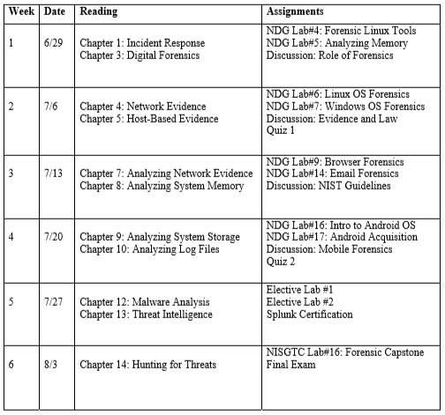
Course Outline - Subject to Minor Changes

Slide 4
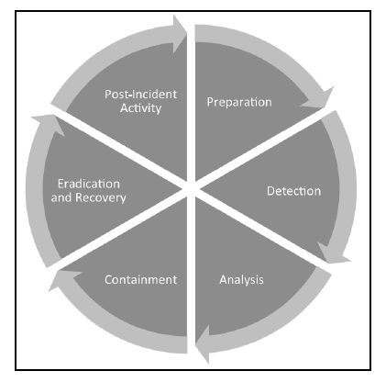
Chapter 1 – Understanding Incident Response

Slide 5
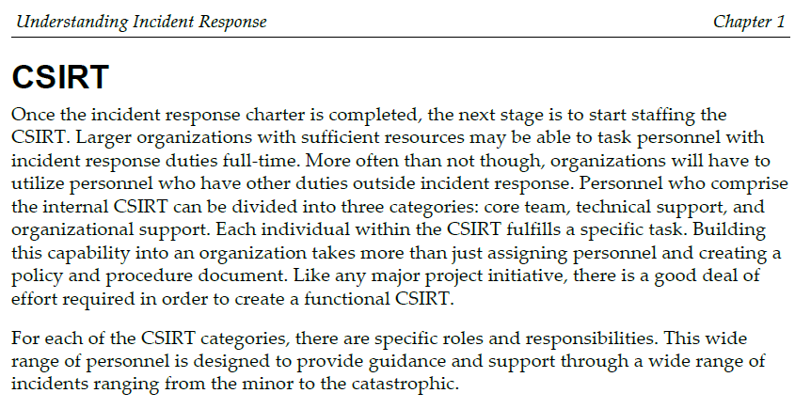
Computer Security Incident Response Team
How Realistic is This?

Slide 6
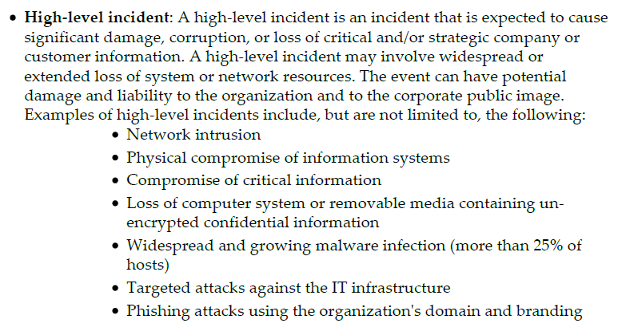
Incident Examples

Slide 7
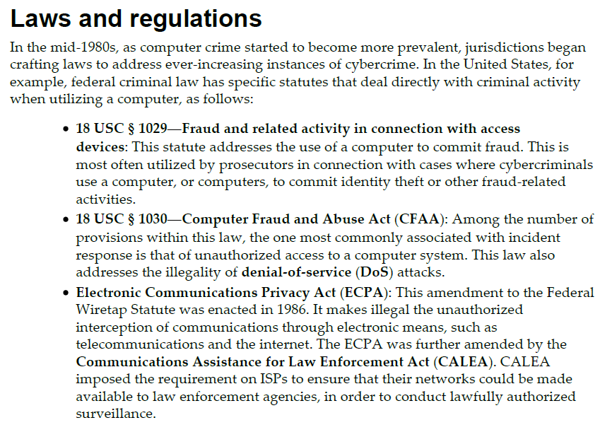
Chapter 3 – Fundamentals of Digital Forensics

Slide 8
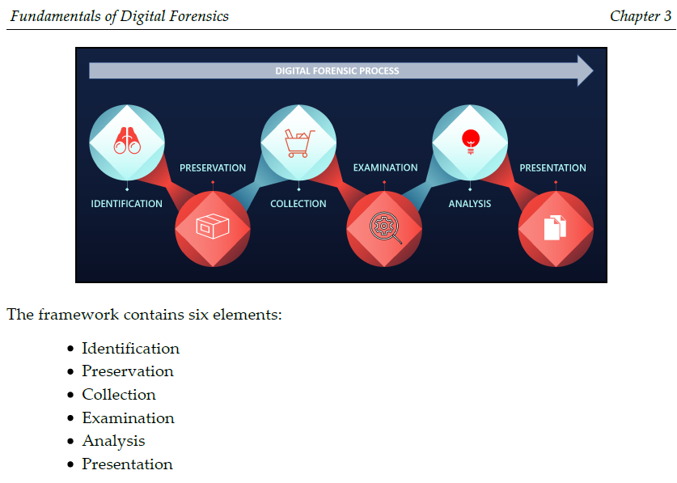

Slide 9
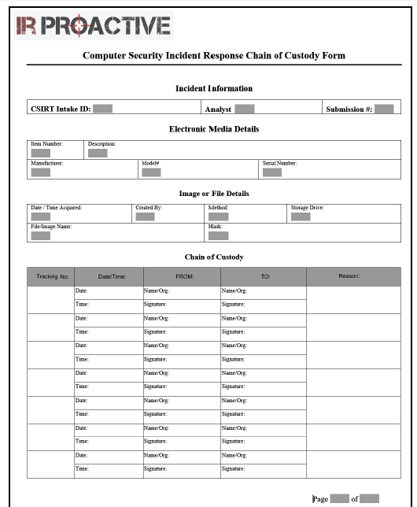

Slide 10
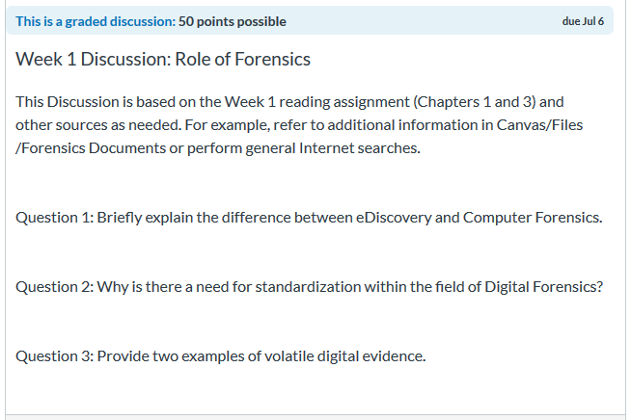
Week 1 Discussion – Good Responses!

Slide 11
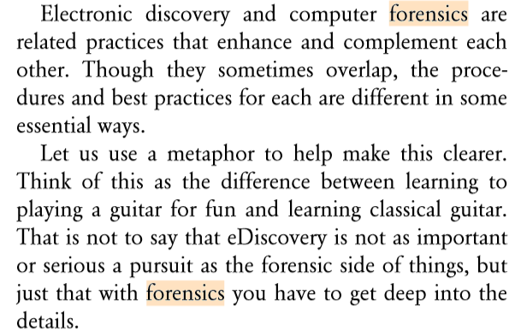

Slide 12
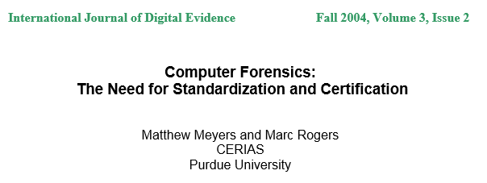
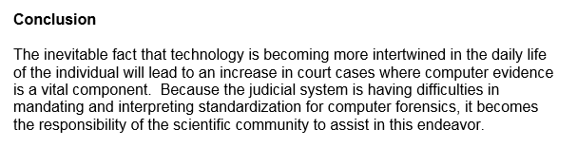

Slide 13
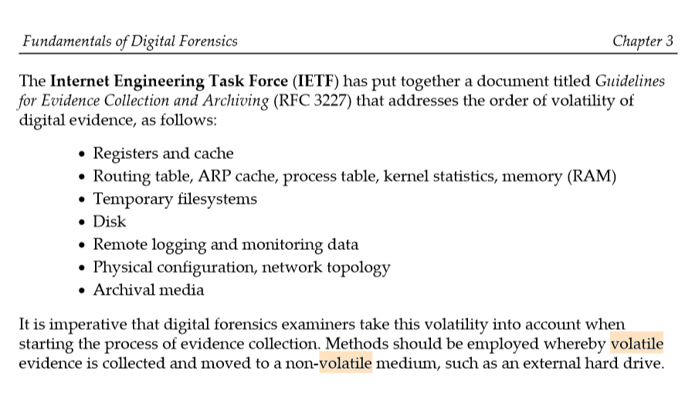

Slide 14
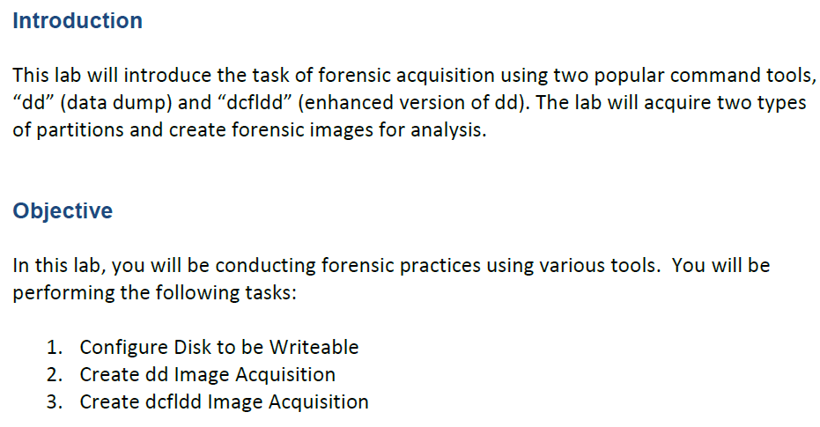

Slide 15
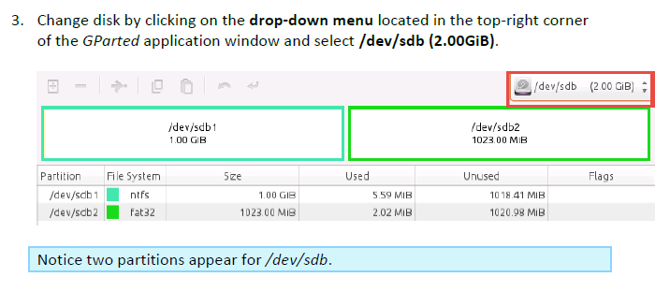
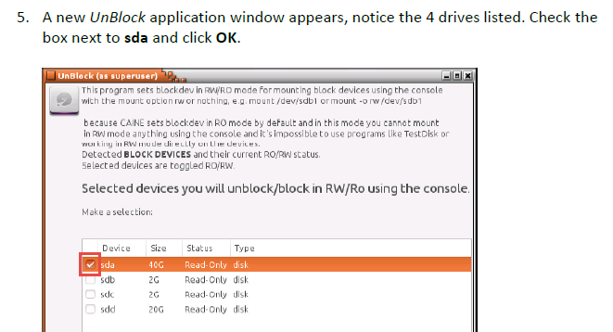

Slide 16
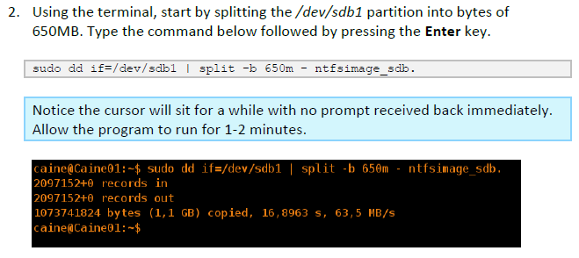
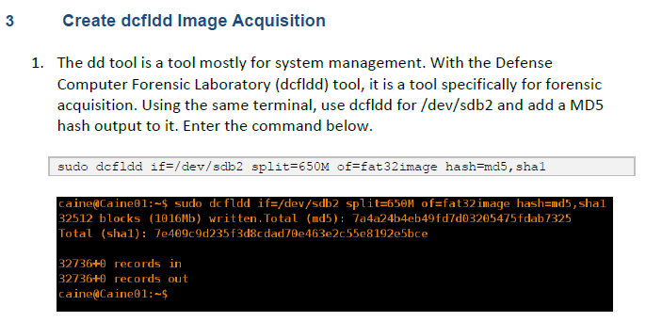

Slide 17
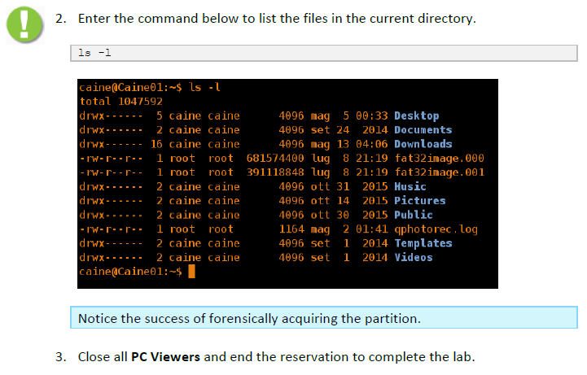

Slide 18
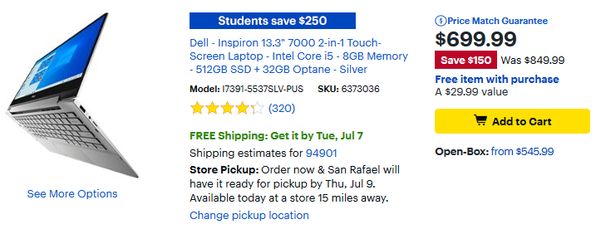
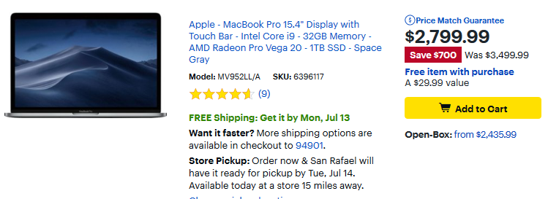
Typical Drive = 512GB to 1TB, Typical Memory 8GB to 32GB

Slide 19
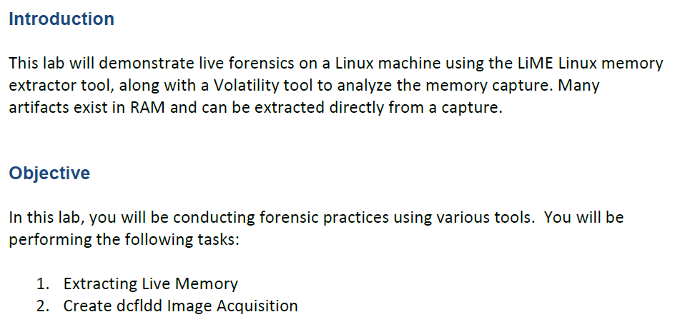

Slide 20
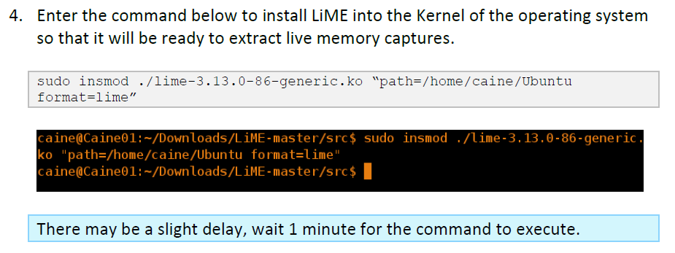
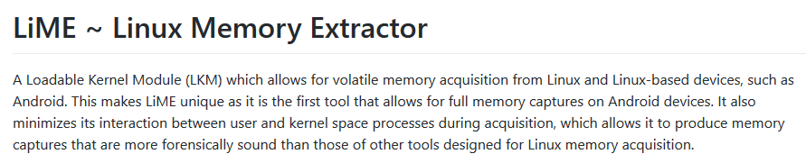
LiME Reference: https://github.com/504ensicslabs/lime

Slide 21
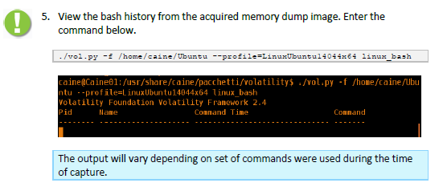
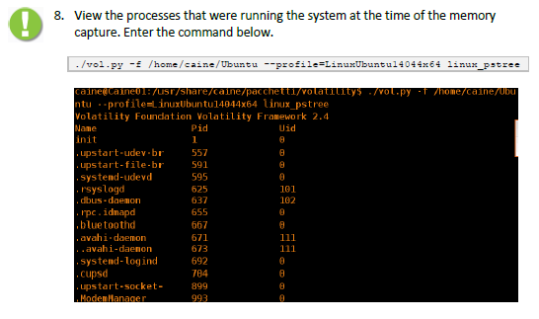

Slide 22
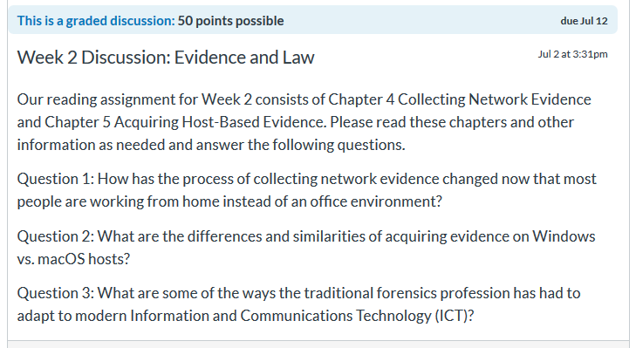
Week 2 Assignment – Discussion Question
Traditional Forensics Example = Fingerprints

Slide 23
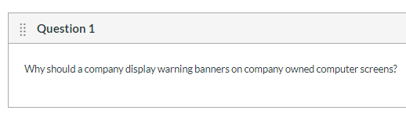
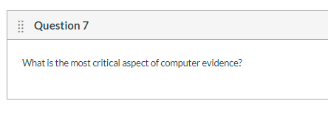
Week 2 Assignment - Quiz 1
10 Multi-Choice Questions, 60 Minute Time Limit

Slide 24
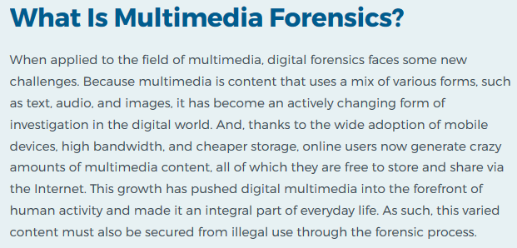
Source: https://resources.infosecinstitute.com/category/computerforensics/introduction/areas-of-study/digital-forensics/multimedia-and-content-forensics/

Slide 25

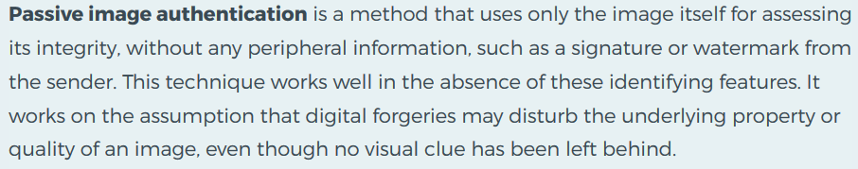

Slide 26
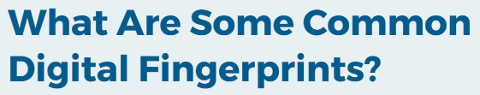
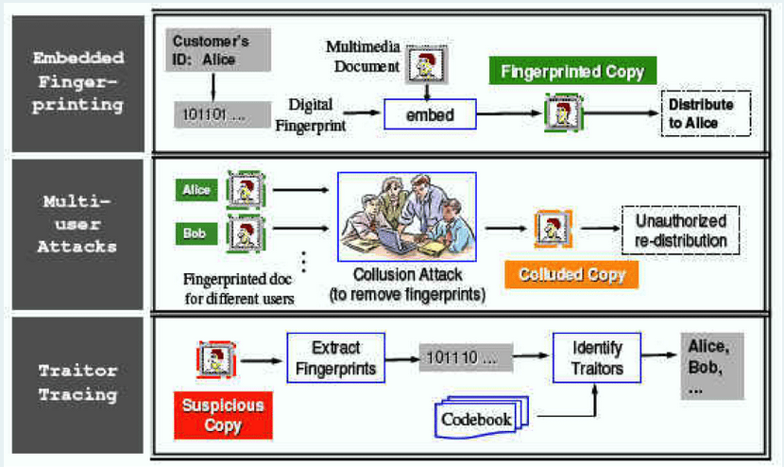

Slide 27
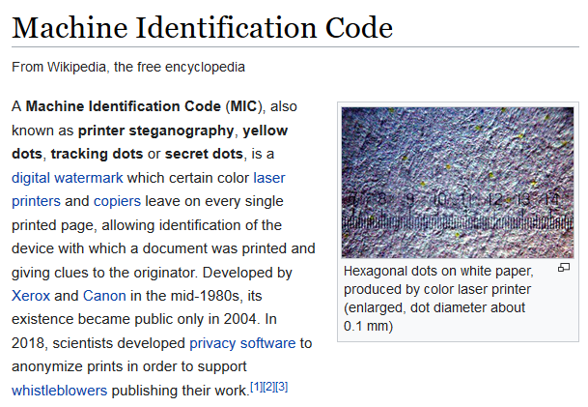
Source: https://en.wikipedia.org/wiki/Machine_Identification_Code

Slide 28
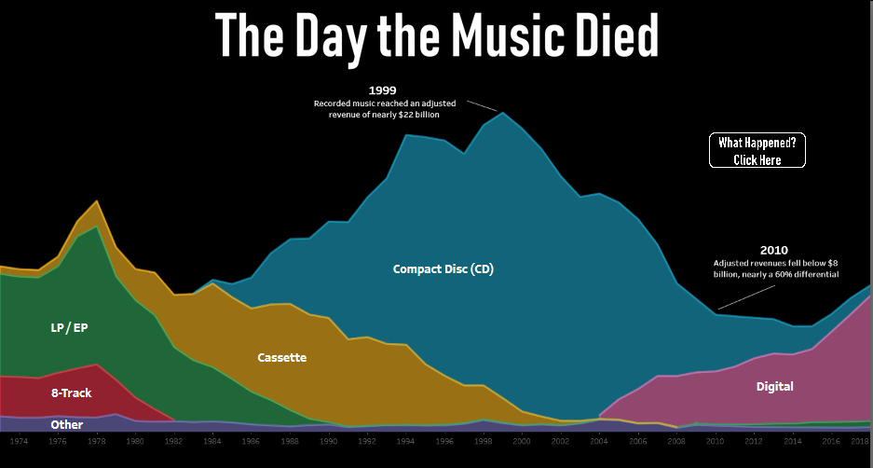

Source: https://public.tableau.com/views/IronViz-TheDaytheMusicDied/TheDaytheMusicDied?:showVizHome=no

Slide 29
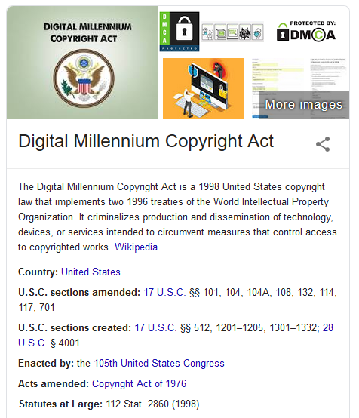

Slide 30

Source: https://www.digitalforensic.in/2018/11/wifi-forensic-investigation.html

Slide 31
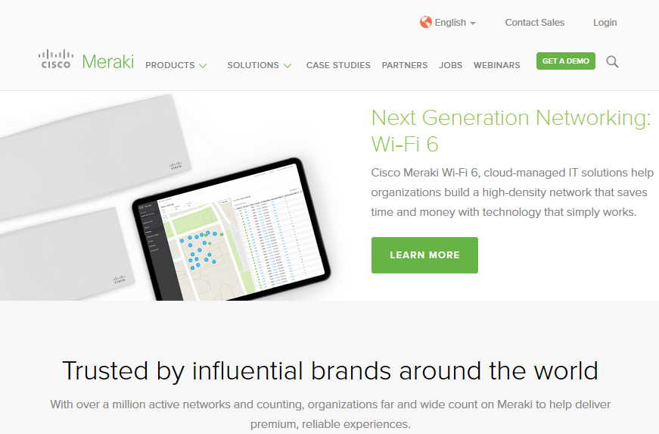

Slide 32
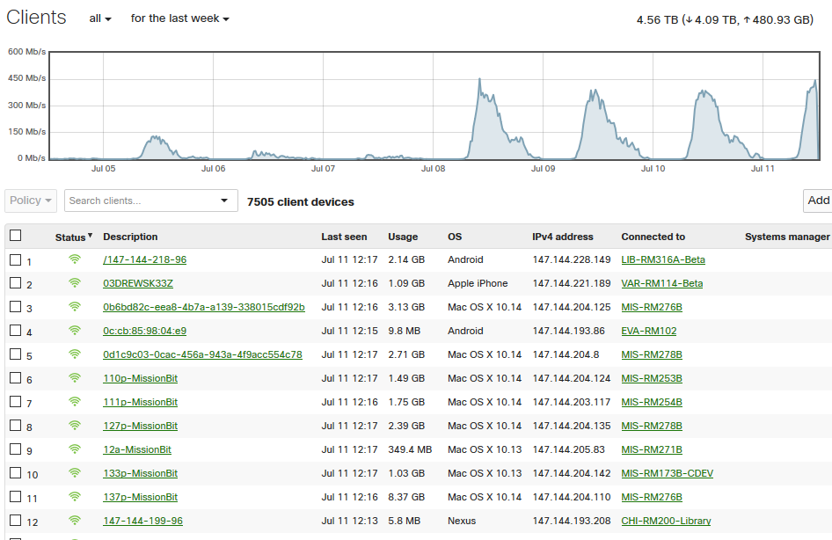
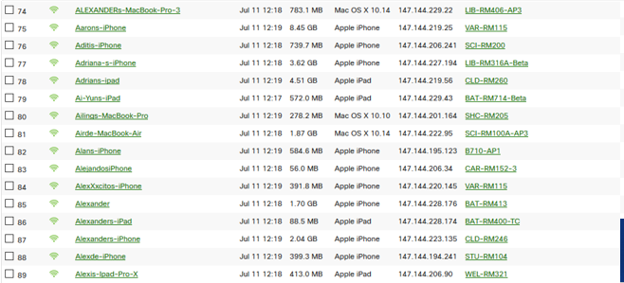

Slide 33
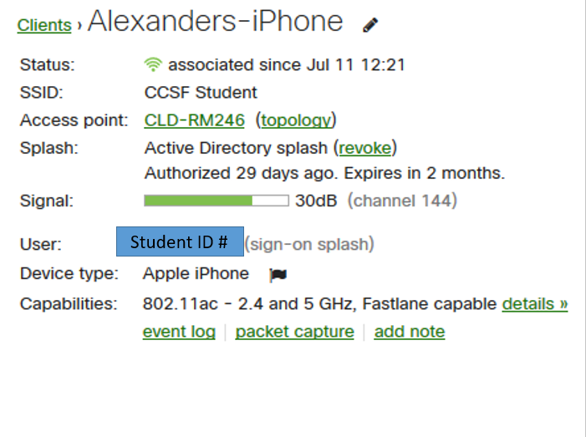

Slide 34
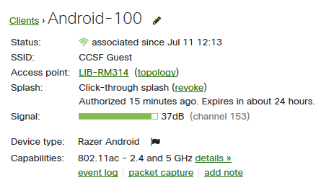

Slide 35
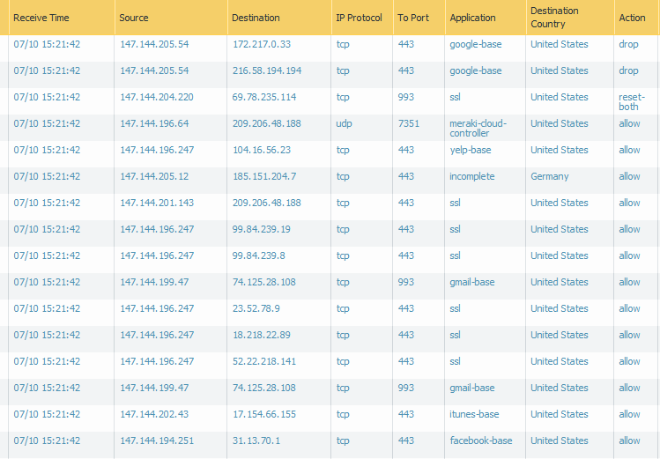
WiFi Firewall Log Example
Log Files Typically Stored 60-90 Days

Slide 36
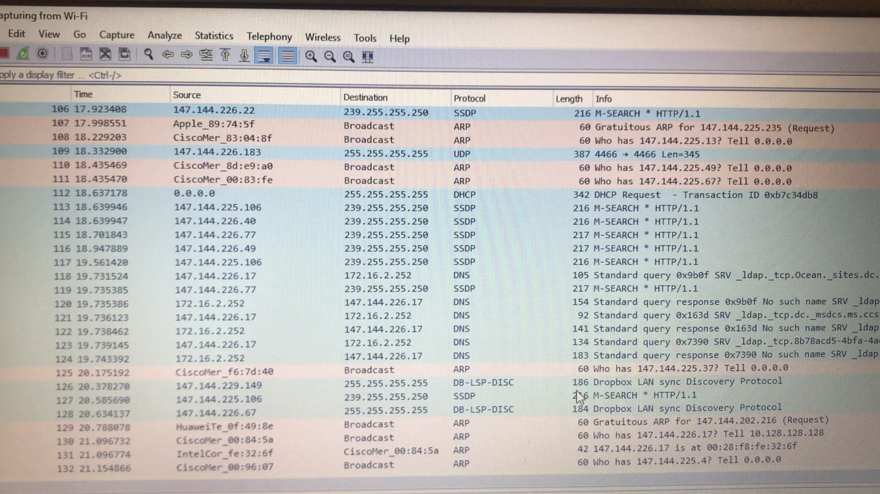
WiFi Wireshark Example
Network Traffic Stream Typically Not Stored

Slide 37
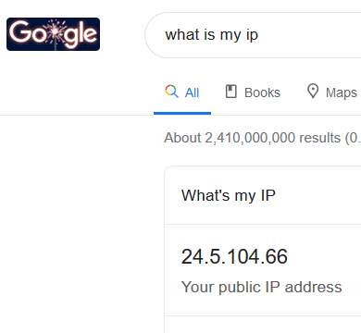
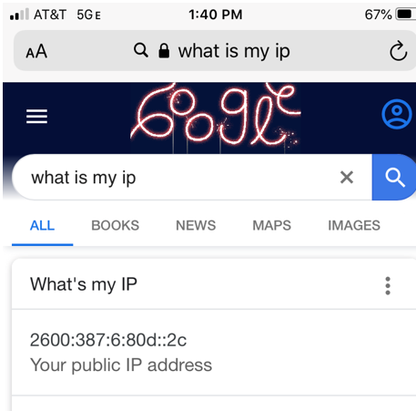
What Is Your IP Address?
Example: IPv4
Example: IPv6

Slide 38
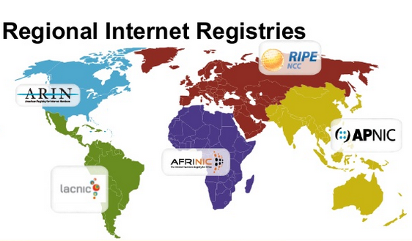
IP Addresses Issued By RIR

Slide 39
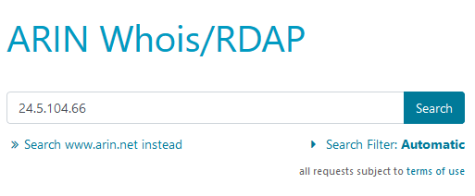
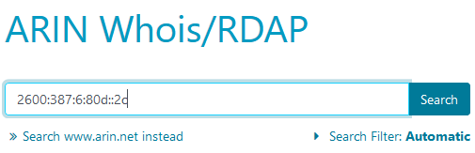
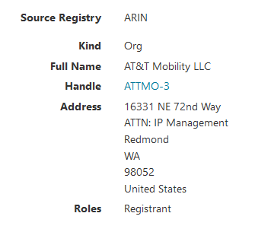
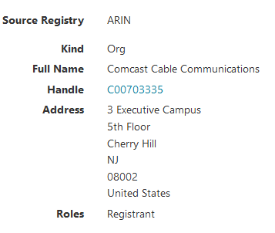
https://www.arin.net/
IPv4 = Comcast
IPv6 = AT&T Mobility

Slide 40
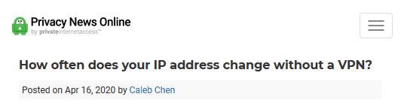

Source: https://www.privateinternetaccess.com/blog/how-often-does-your-ip-address-change-without-a-vpn/

Slide 41

Dynamic Host Control Protocol
Assigns IP Address, Stores Name and Hardware Address

Slide 42

Internet Architecture
Autonomous Systems with Unique AS#

Slide 43

Autonomous Systems Per Country (ISPs)
Source: https://www.whatismyip.com/asn/

Slide 44

Autonomous Systems Per Country (ISPs)

Slide 45

What Is Your ASN?
www.whatismyasn.org

Slide 46


Source: https://www.jdsupra.com/legalnews/hide-and-seek-plaintiff-permitted-to-54681/

Slide 47

Source: https://blog.cloudflare.com/the-deep-dive-into-how-verizon-and-a-bgp-optimizer-knocked-large-parts-of-the-internet-offline-monday/

Slide 48


Source: https://stat.ripe.net/widget/bgplay#w.resource=20057

Slide 49


Slide 50


Slide 51


June, 2019 Outages
Google, Cloudflare, Apple, Facebook, Twitter
Source: https://techcrunch.com/2019/07/05/bad-month-for-the-internet/

Slide 52

NTP – Very Important In Forensics

Slide 53


Slide 54


Slide 55



Slide 56



Slide 57


Slide 58



Slide 59



Slide 60


